Slide 1
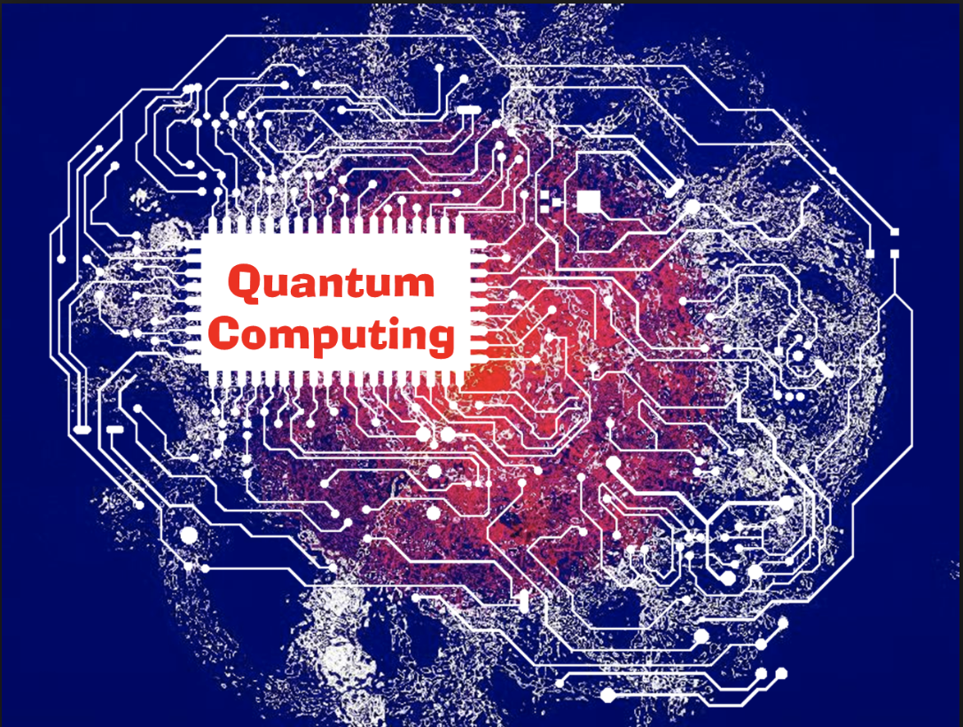
Quantum Deep Learning
Undergraduate Study #5
Hanjin Choi, Myungwoo Song. Korea University, School of Electrical Engineering
zxa018@korea.ac.kr
erados@korea.ac.kr

Slide 2
Contents
Introduction to Deep Learning
Classical Optimizer
Paper Review
Efficient encoding of the weighted MAX k-CUT on quantum computer using QAOA
Learning to Optimize Variational Quantum Circuits to Solve Combinatorial Problems

Slide 3
Introduction to Deep Learning

Slide 4
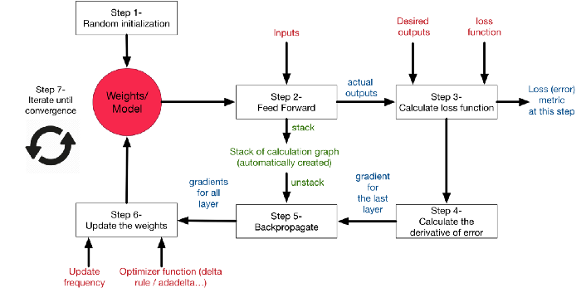
Introduction to Deep Learning
https://medium.com/datathings/neural-networks-and-backpropagation-explained-in-a-simple-way-f540a3611f5e

Slide 5
Classical Optimizer
Batch Gradient Descent
Naive Stochastic Gradient Descent
Momentum Gradient Descent
Nesterov Accelerated Gradient
Adagrad
RMSProp
Quantum Natural Gradient
Nelder-Mead method
COBYLA

Slide 6
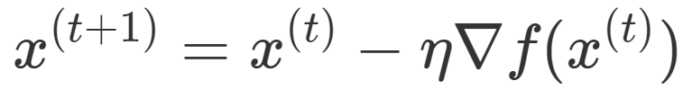
Batch Gradient Descent(Vanilla Gradient Descent)
Calculates all sample’s gradient.
If samples are too many, because of lack of memory BGD can not be implemented.
Takes longer time than other optimization algorithms.
Advantage for parallel computation.
Hard to get out of local optima.

Slide 7
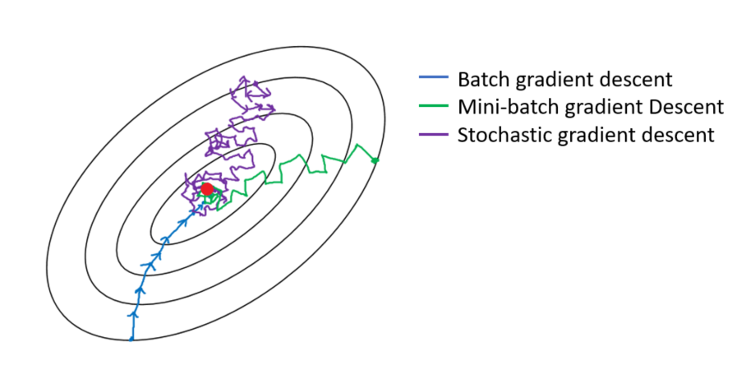
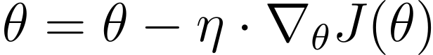
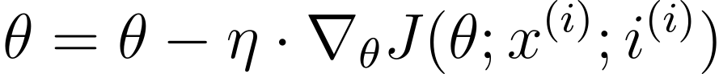
Naive Stochastic Gradient Descent
Algorithm that uses single sample to update the parameter instead of the whole batch. There also is a Mini-batch Gradient Descent algorithm that brings the advantages of both SGD and BGD.

Slide 8
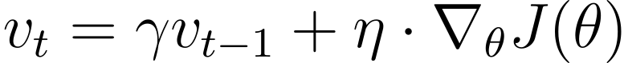
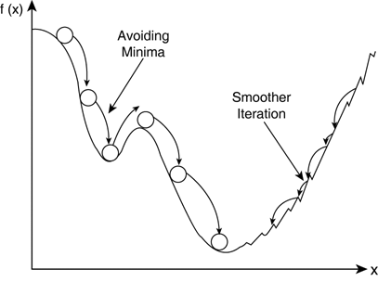
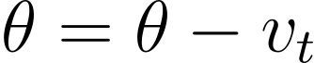
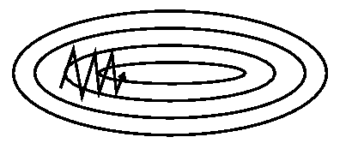
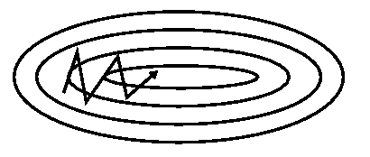
Momentum Gradient Descent
Algorithm that remembers previous movement, exponentially weights it and add to current step. By doing so, the learning process gets momentum.
https://arxiv.org/pdf/1609.04747.pdf
http://www.yaldex.com.

Slide 9
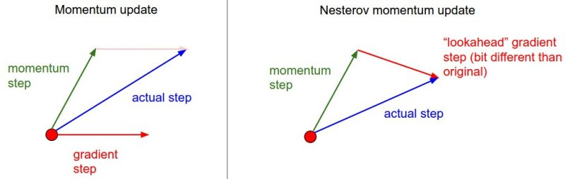
Nesterov Accelerated Gradient (NAG)
Similar to MGD, but calculate the gradient step after considering the effect of momentum step. By doing so, it can look ahead which direction to go.

Slide 10
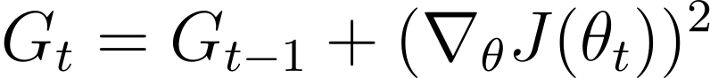
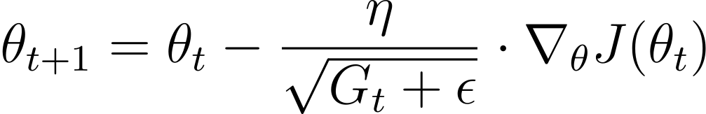
Adagrad
Algorithm that differentiate the learning rate of each parameters by dividing eta by RMS of gradients.
element-wise square

Slide 11
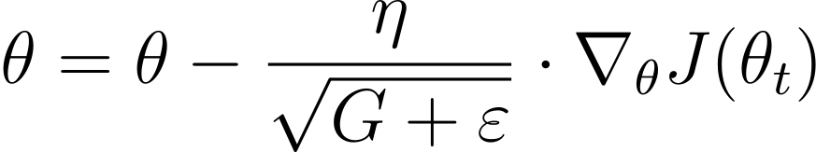
RMSProp
Similar to Adagrad, but it uses exponentially weighted moving average instead of square summation.

Slide 12
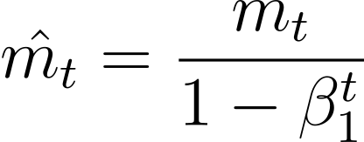
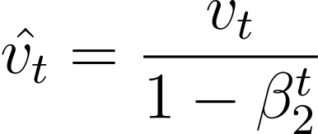
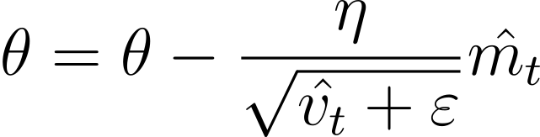
ADAM
An algorithm that merges RMSProp and MGD.
Unbiasing
from zero

Slide 13
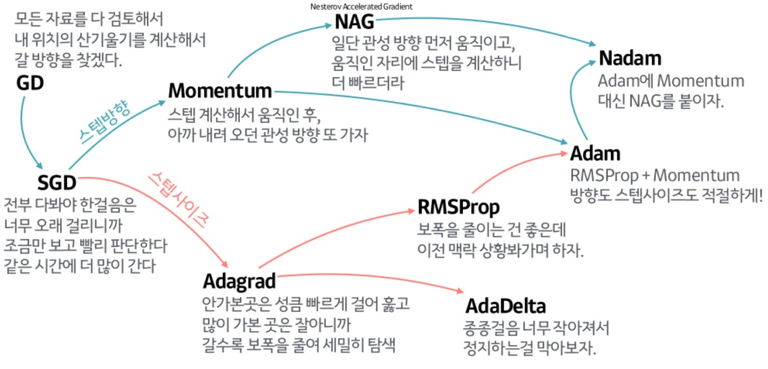
https://www.slideshare.net/yongho/ss-79607172

Slide 14
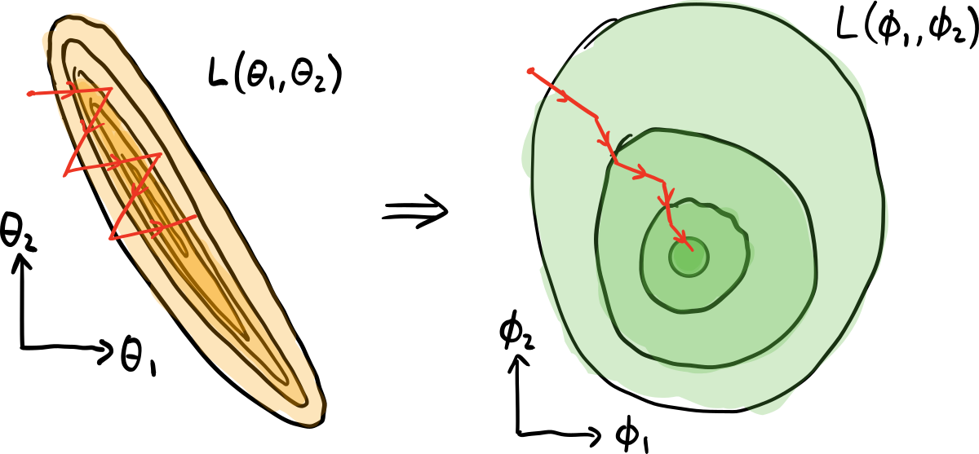
Quantum Natural Gradient
https://pennylane.ai/qml/demos/tutorial_quantum_natural_gradient.html
Updating each parameter by the same Euclidean distance does not change cost function with same rate with respect to each parameter.
By changing coordinate system(re-parametrization) of the cost function we can have nicer geometry.

Slide 15
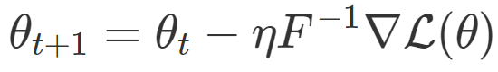
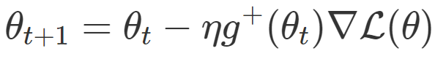
Quantum Natural Gradient
Fisher information matrix
Natural Gradient Descent
Quantum Natural Gradient
Fubini-Study metric tensor

Slide 16
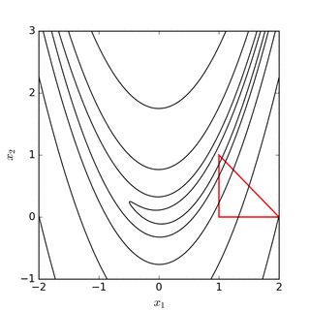
Nelder-Mead Method
Using Simplex for finding minimum or maximum.
Memory efficiency. It only takes N+1 vertices.
More iteration than other optimization algorithms.
Order
Calculate centroid
Reflection
Expansion or Contraction
Shrink
https://en.wikipedia.org/wiki/Nelder%E2%80%93Mead_method

Slide 17
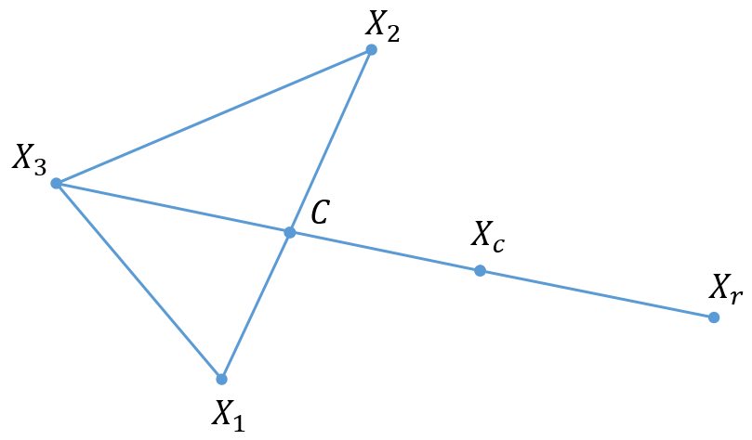

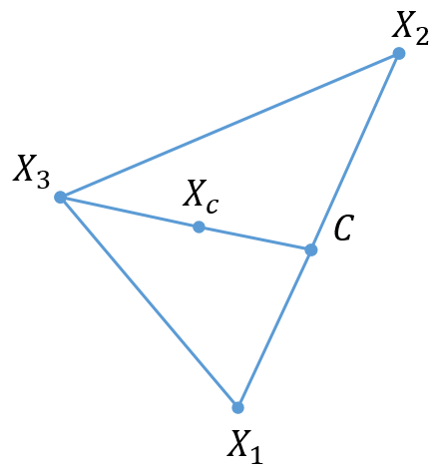
Nelder-Mead Method
Expansion
Contraction
case1
https://light-tree.tistory.com/174
case2

Slide 18
COBYLA
Constrained Optimization BY Linear Approximation
Gradient-free optimization algorithm.
A linear interpolation of the objective function is create by objective function of each vertex of the simplex.
The size of the trust region is controlled by the algorithm.
Initial and final values of the trust region are set by the user.
Whenever the objective function and/or constraints are non smooth, it is recommended to use COBYLA.

Slide 19
Paper Review
Efficient encoding of the weighted MAX k-CUT on quantum computer using QAOA
Learning to Optimize Variational Quantum Circuits to Solve Combinatorial Problems

Slide 20
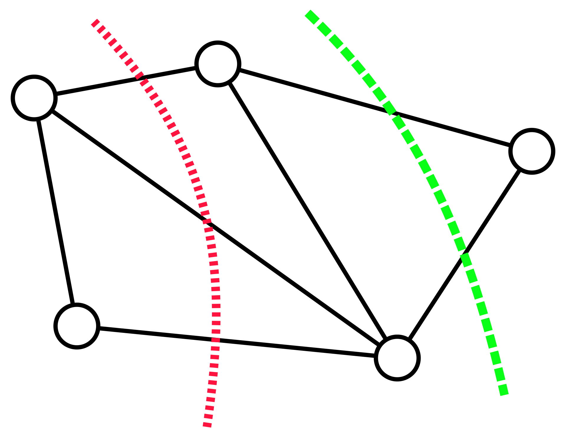
Efficient encoding of the weighted MAX k-CUT on quantum computer using QAOA
The weighted MAX k-CUT problem consists of finding a k-partition of a given weighted undirected graph such that the sum of the weights of the crossing edges is maximized.

Slide 21
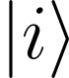
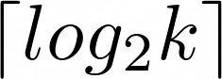
Efficient encoding of the weighted MAX k-CUT on quantum computer using QAOA
There are three different possibilities of encoding the problem.
Qudit encoding k-level quantum system is not available.
One-hot encoding Using k bits for each vertex. If k = 4, then each vertex has bit strings 0001, 0010, 0100 or 1000.
Binary encoding Each vertex belonging to one of the sets by , which requires L = . If k = 4, then each vertex has bit strings 00, 01, 10, or 11.

Slide 22
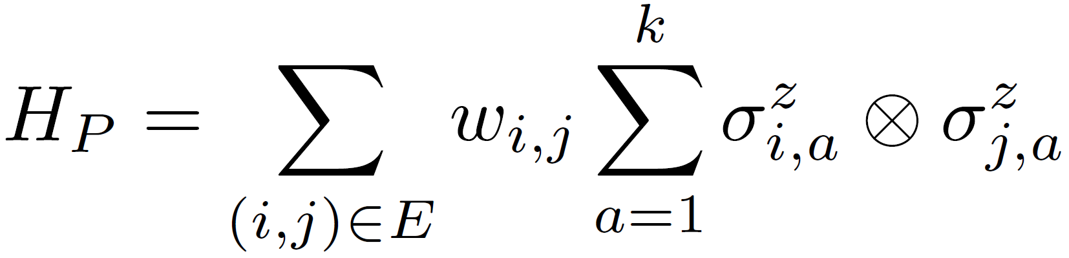
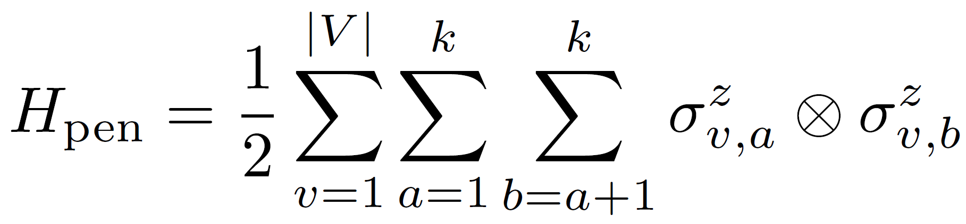
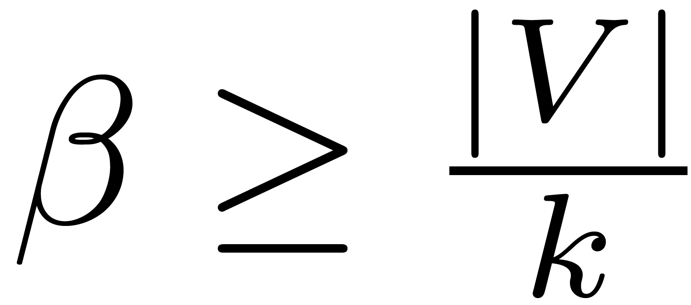
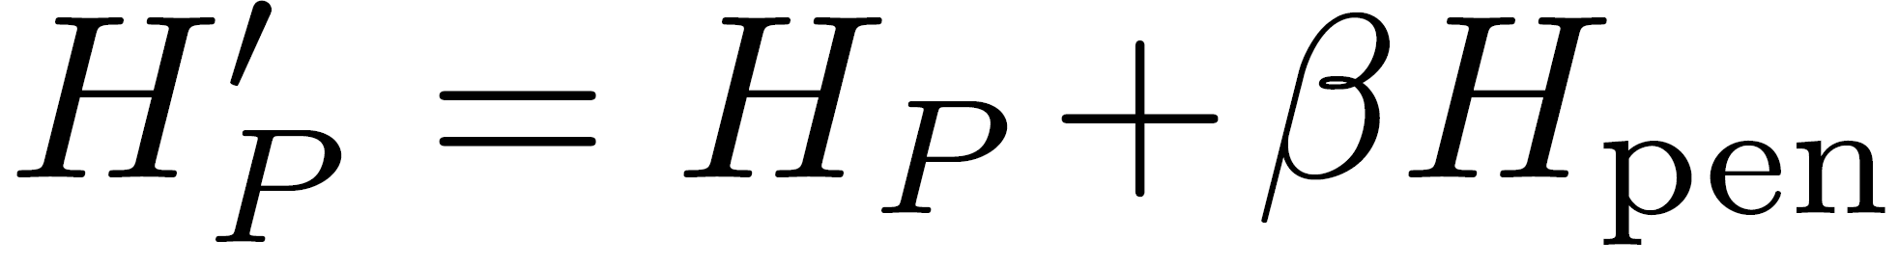
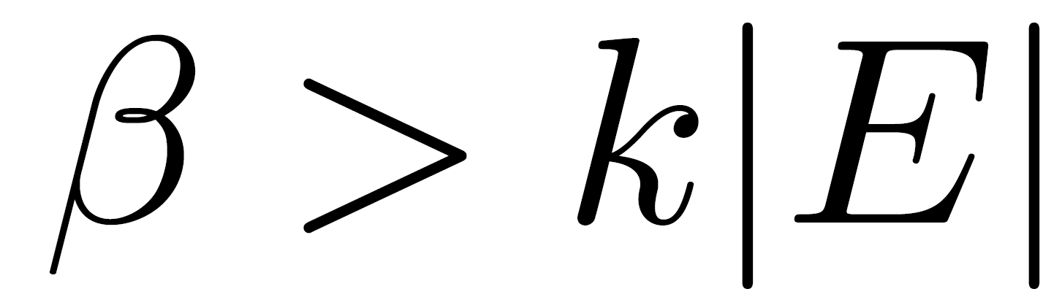
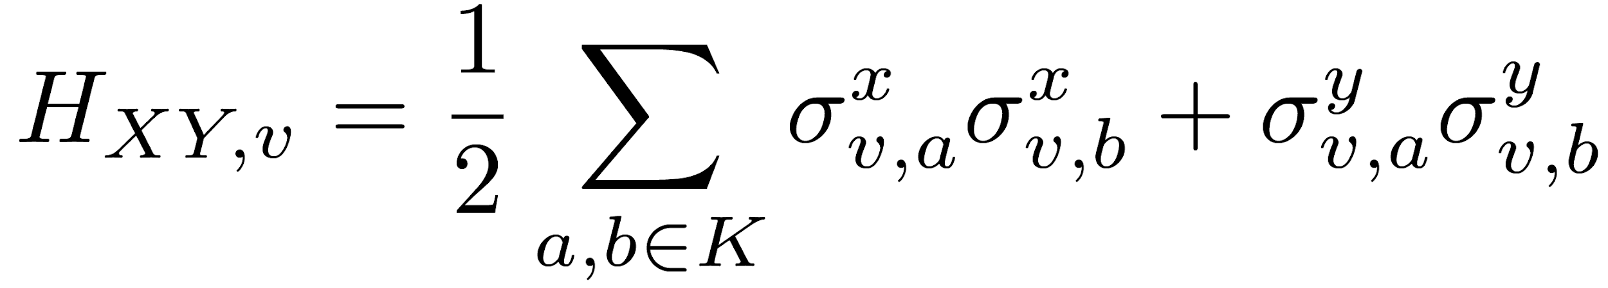
Efficient encoding of the weighted MAX k-CUT on quantum computer using QAOA
One-hot encoding
Problem Hamiltonian , Hamiltonian becomes a weighted sum where
Unitary Evolution XY-mixer .

Slide 23
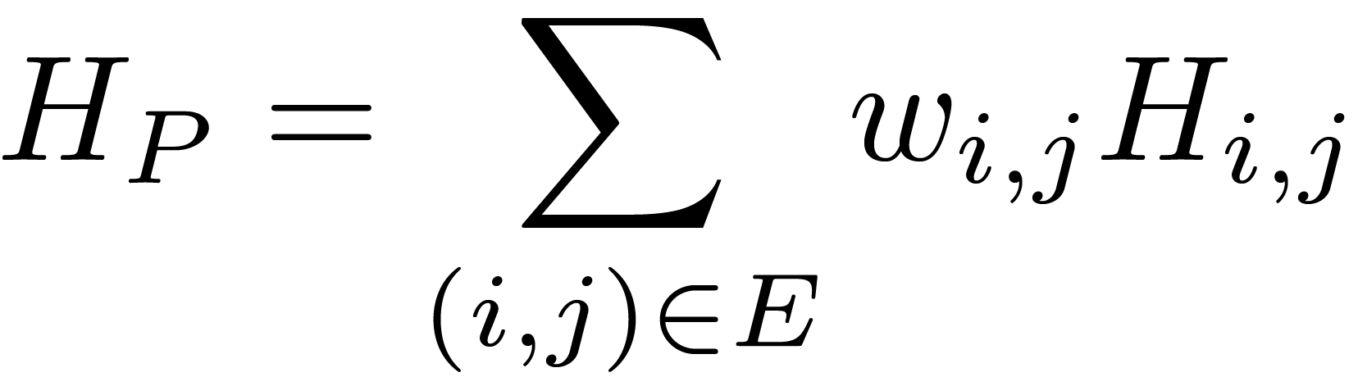
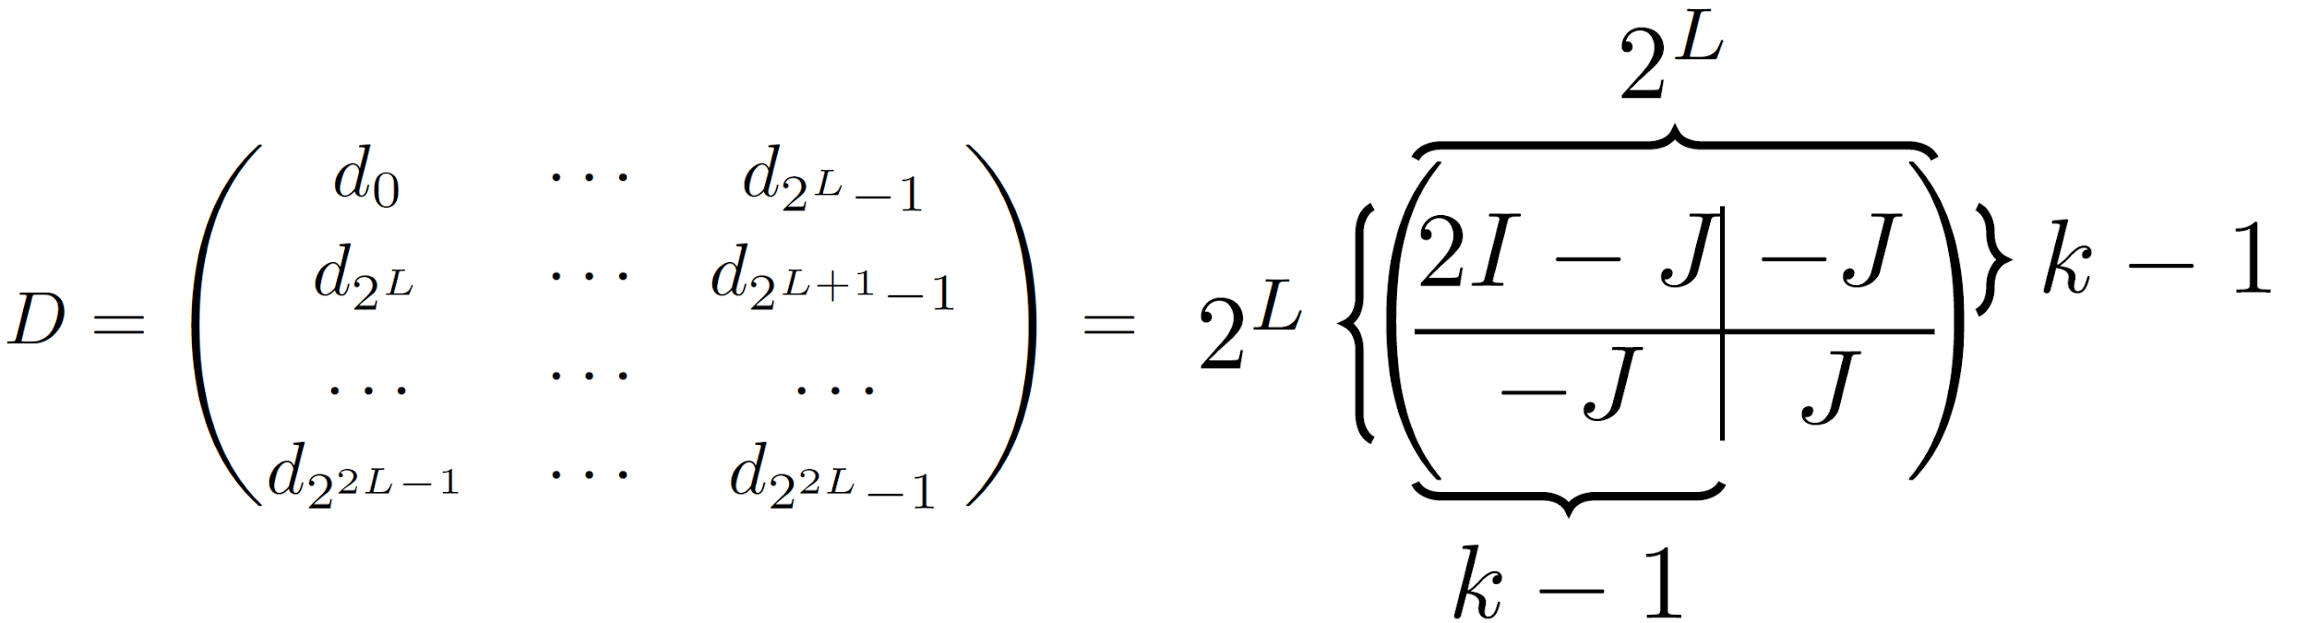
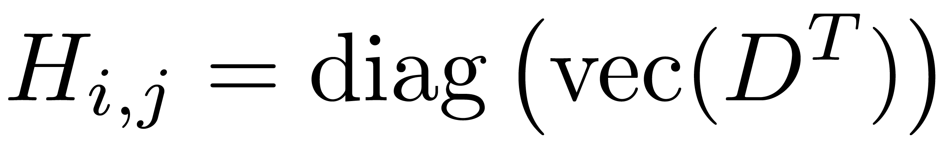
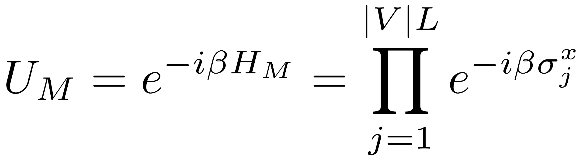
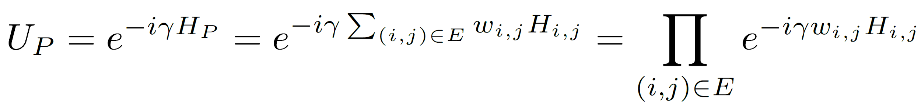
Efficient encoding of the weighted MAX k-CUT on quantum computer using QAOA
Binary Encoding
Problem Hamiltonian I is the identity matrix, J is a matrix of ones.
Unitary Evolution Mixing operator Phase separation operator

Slide 24
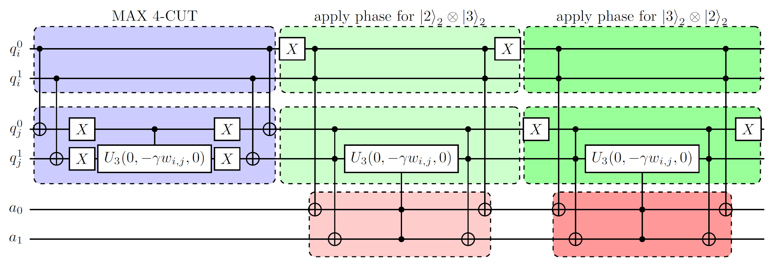
Efficient encoding of the weighted MAX k-CUT on quantum computer using QAOA
Implementation of the phase operator for the edge(i, j) for MAX 3-CUT.
Two circuits after MAX 4-CUT circuit vanish if k is power of 2.

Slide 25
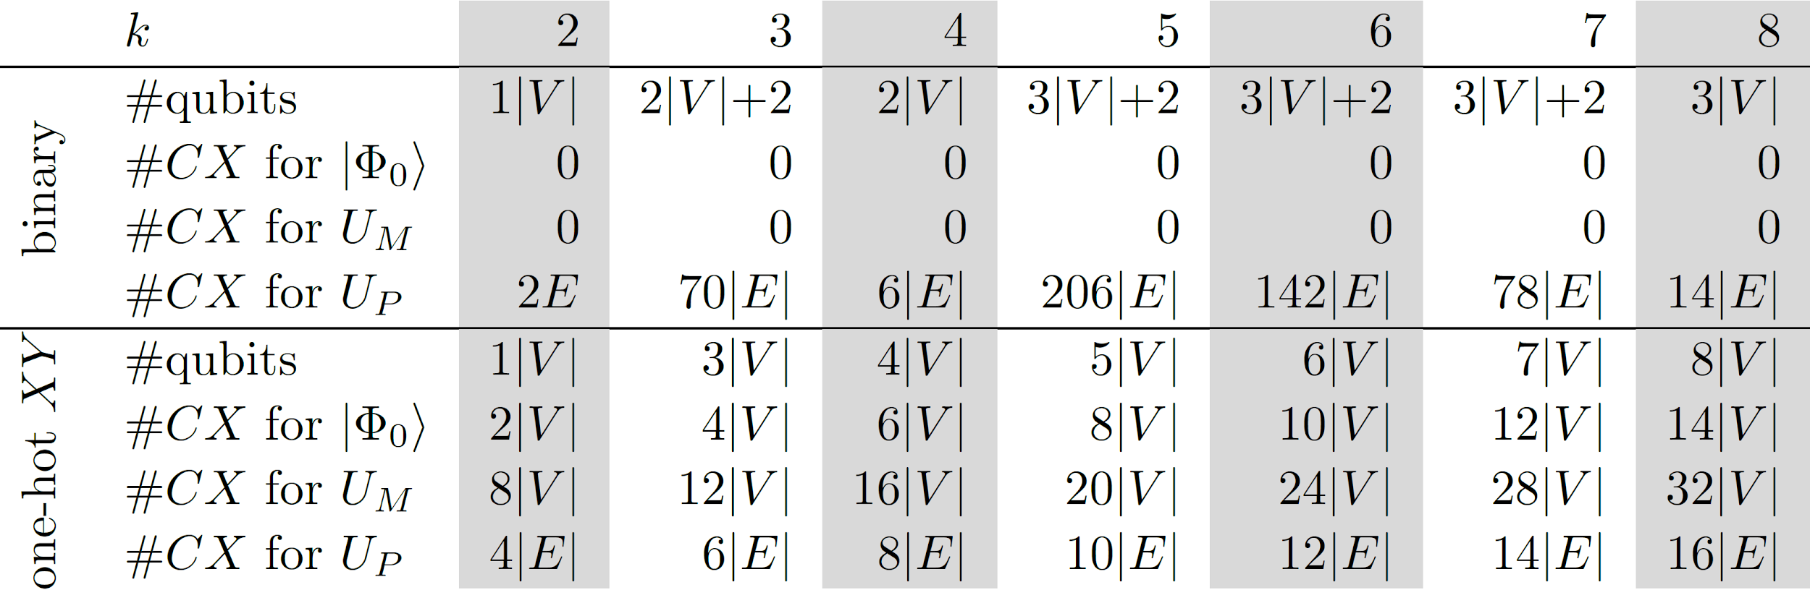
Efficient encoding of the weighted MAX k-CUT on quantum computer using QAOA
Number of CX-operations per layer and number of qubits of the QAOA circuit for graph G = (V, E) depending on k.
#CX for Up in binary encoding is very high if k is not power of 2.

Slide 26
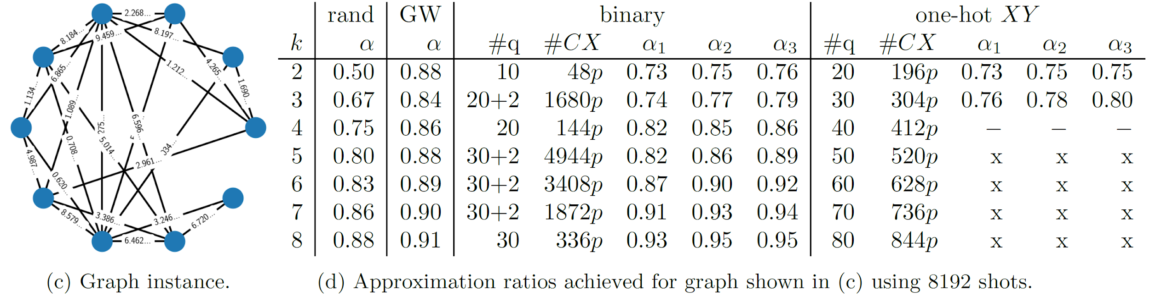
Efficient encoding of the weighted MAX k-CUT on quantum computer using QAOA
When k is small, the approximation ratio alpha is not bigger than classical algorithm.
When k is big, one-hot encoding can not be implemented.

Slide 27
Paper Review
Efficient encoding of the weighted MAX k-CUT on quantum computer using QAOA
Learning to Optimize Variational Quantum Circuits to Solve Combinatorial Problems

Slide 28
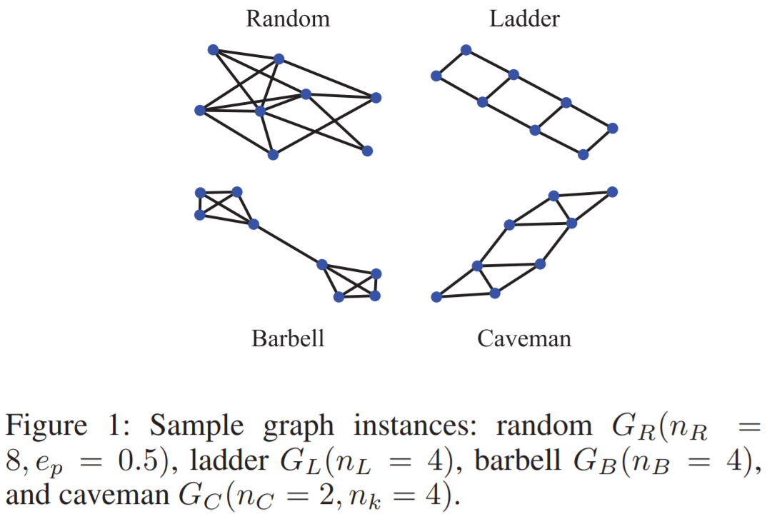
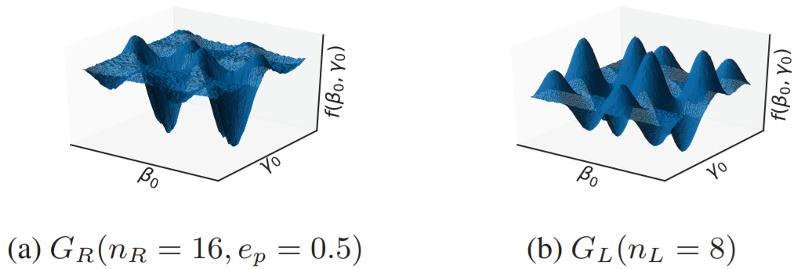
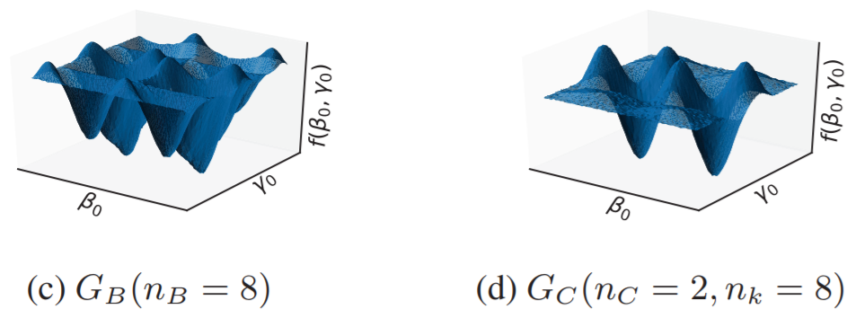
Learning to Optimize Variational Quantum Circuits to Solve Combinatorial Problems

Slide 29
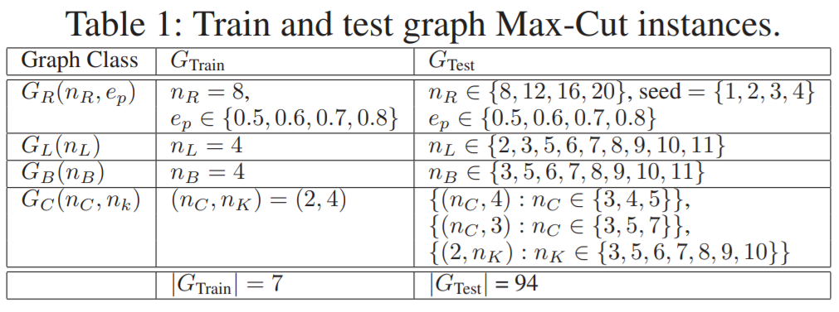
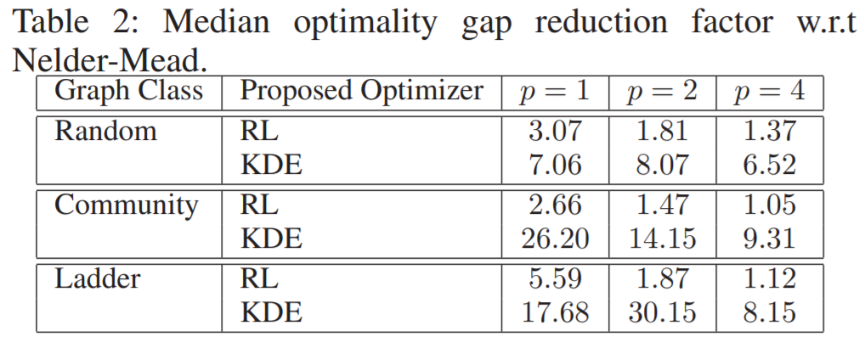
Learning to Optimize Variational Quantum Circuits to Solve Combinatorial Problems

Slide 30
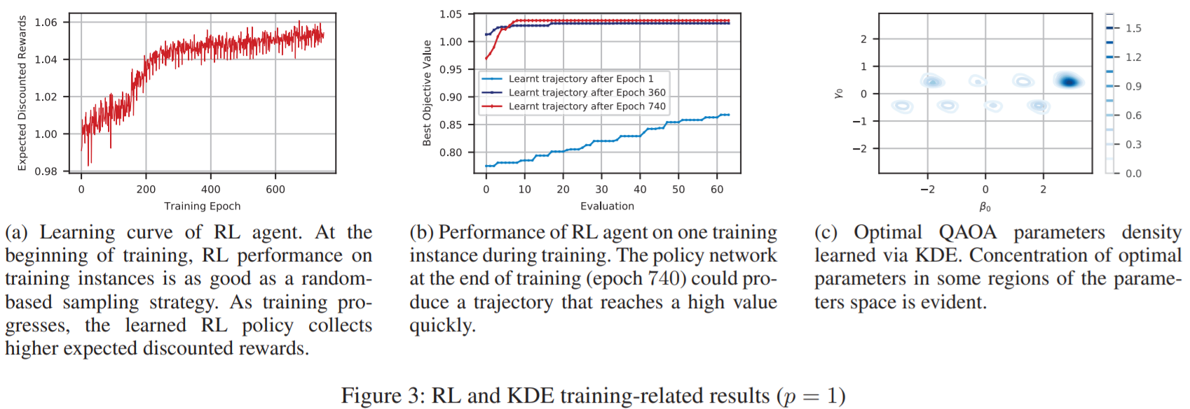
Learning to Optimize Variational Quantum Circuits to Solve Combinatorial Problems

Slide 31
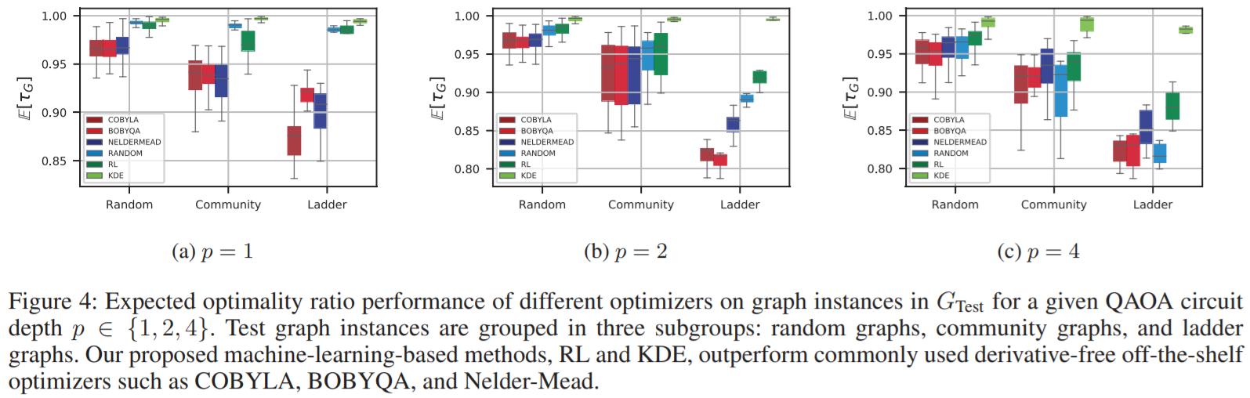
Learning to Optimize Variational Quantum Circuits to Solve Combinatorial Problems

Slide 32
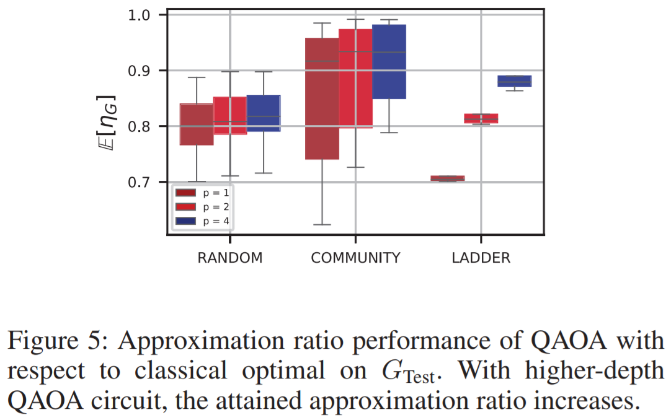
Learning to Optimize Variational Quantum Circuits to Solve Combinatorial Problems

